Slide 1
BATCH 2
WEEK 8 SOLID TEAM REPORT

Slide 2
WEEKLY OBJECTIVES
MODIFY THE CASE FABRICATION PROCESS.
COOK 1 GRAIN FROM SCRATCH.
CREATE MORE CASTING TOOLS.
PREP THE TWO GRAIN MOTOR.

Slide 3
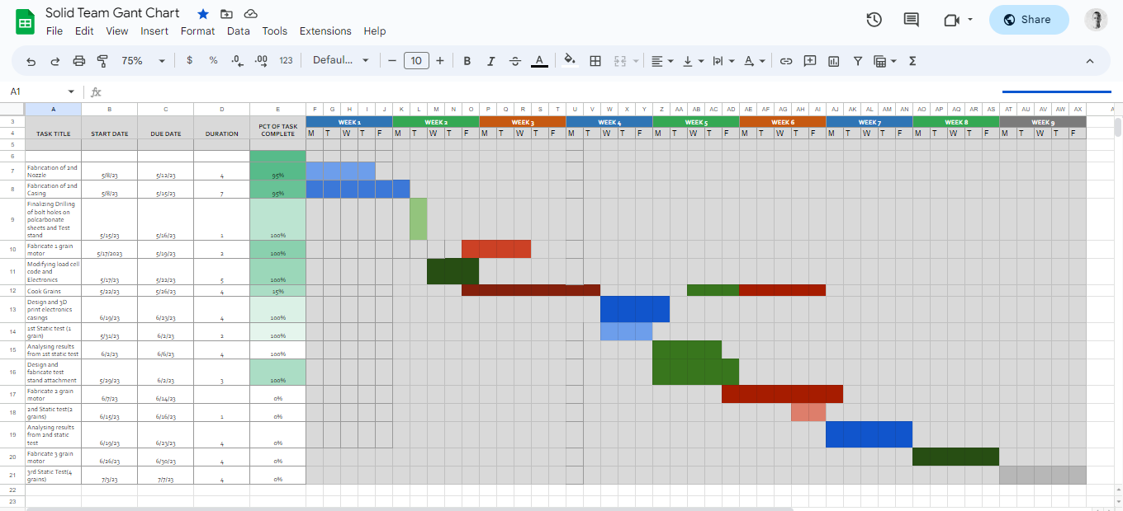
Gantt chart
https://docs.google.com/spreadsheets/d/1hBBPNcnpQUVeR51bRd35yVVWFX5lDWHhBGYU0TpIXSk/edit#gid=0

Slide 4
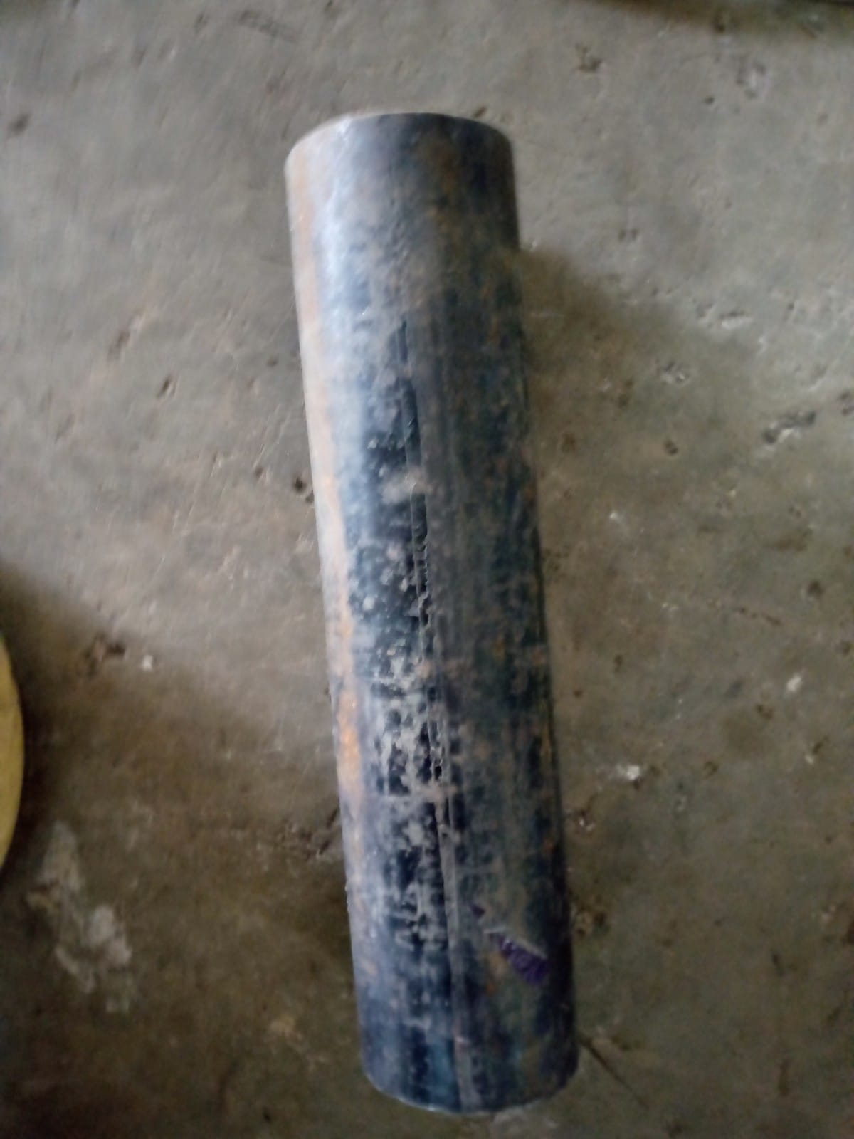
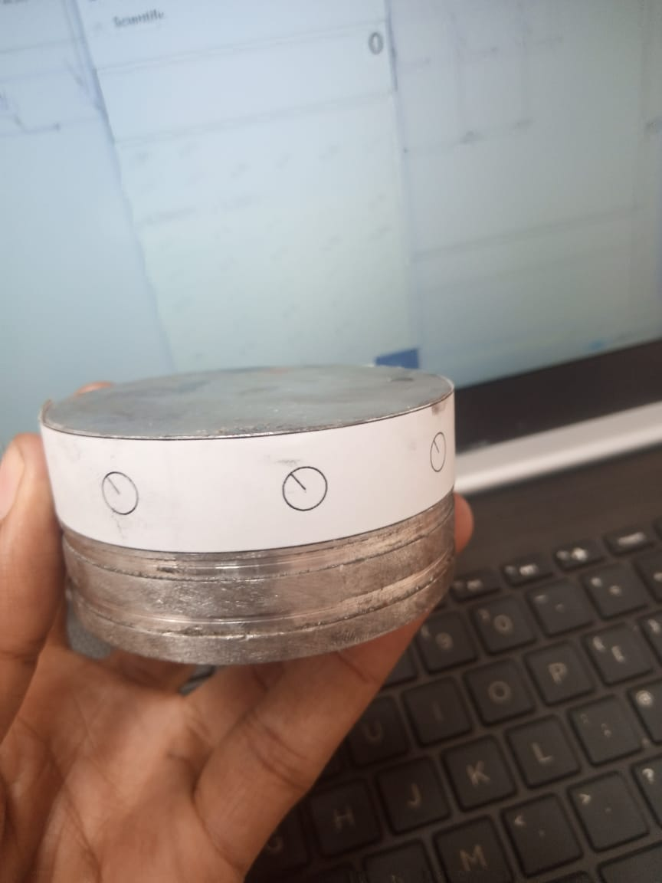
MODIFY CASE FABRICATION PROCESS

Slide 5
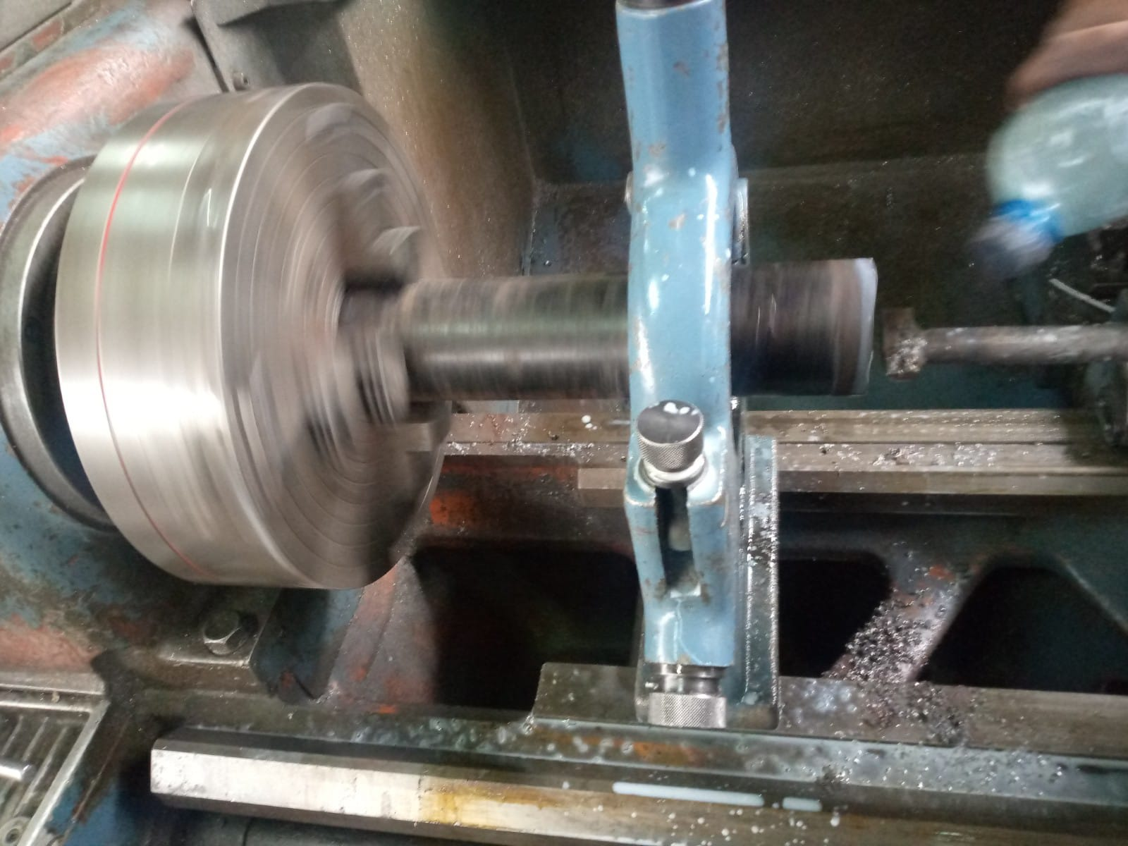
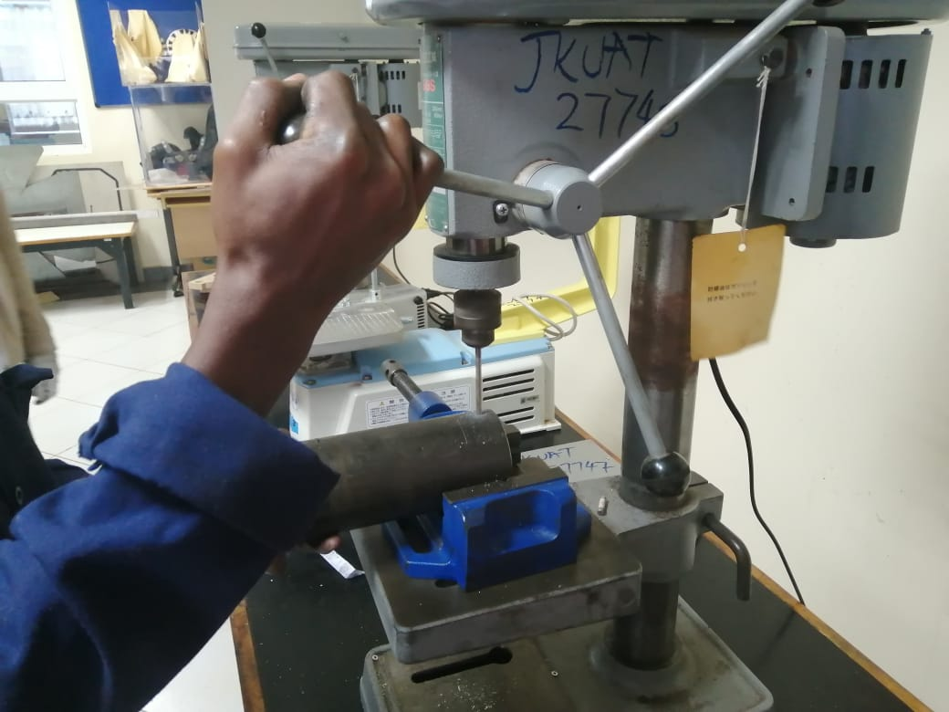
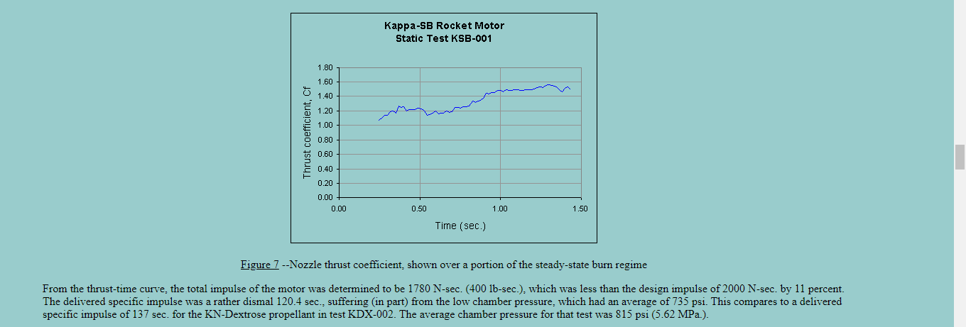
PREP THE 2 GRAIN MOTOR

Slide 6
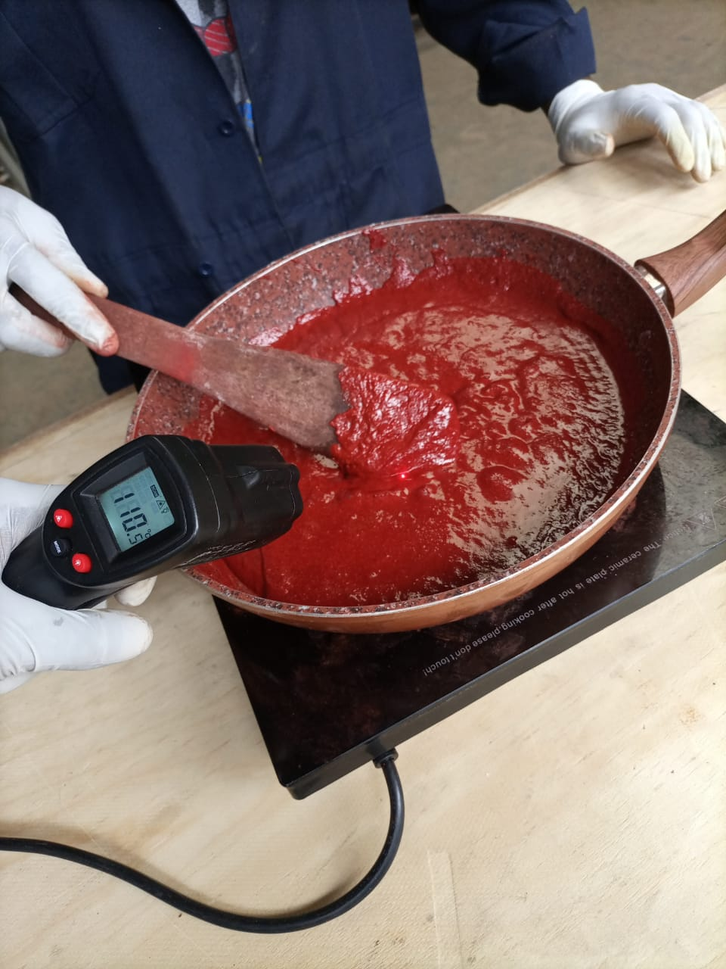
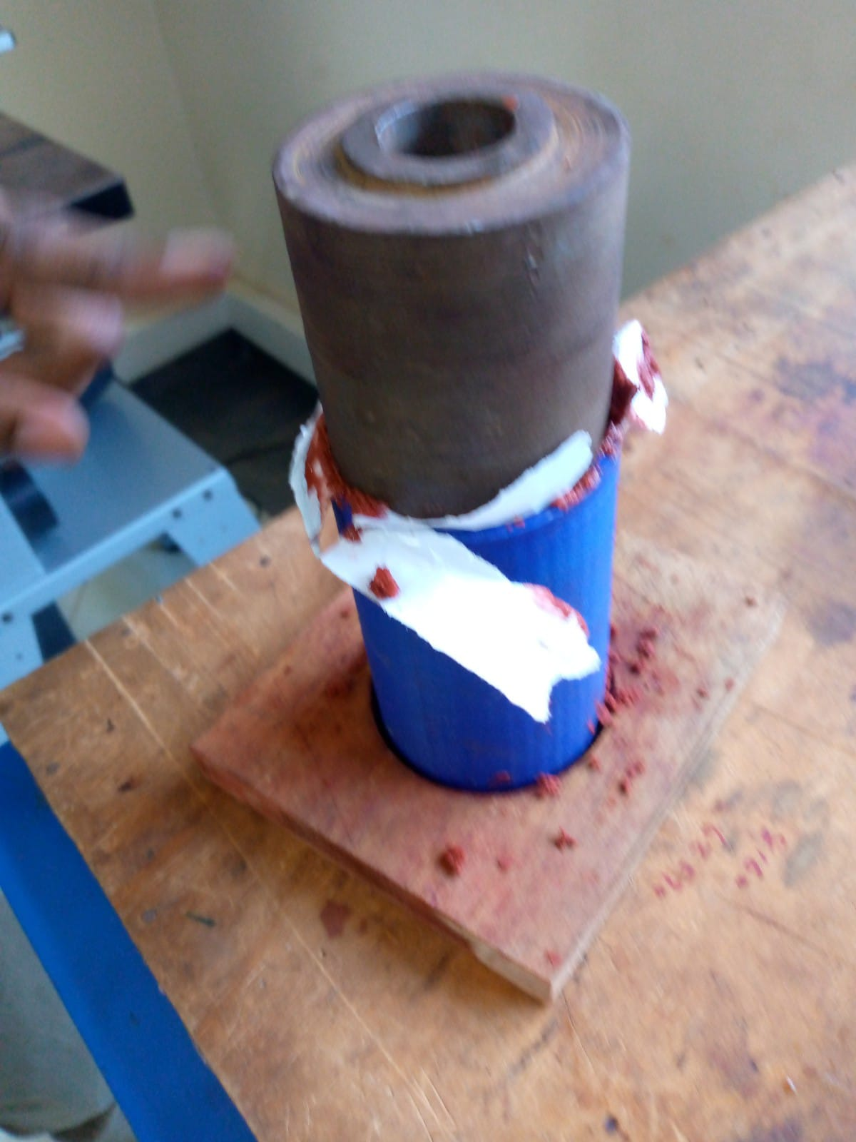
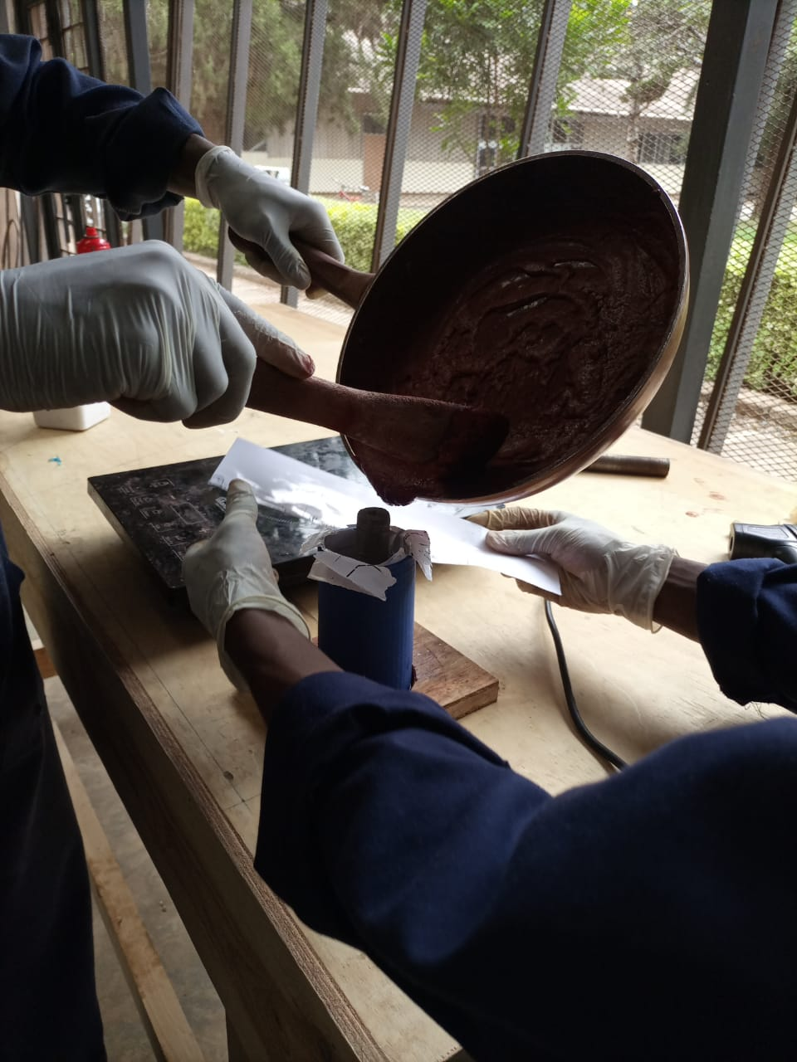
COOK 1 GRAIN FROM SCRATCH

Slide 7
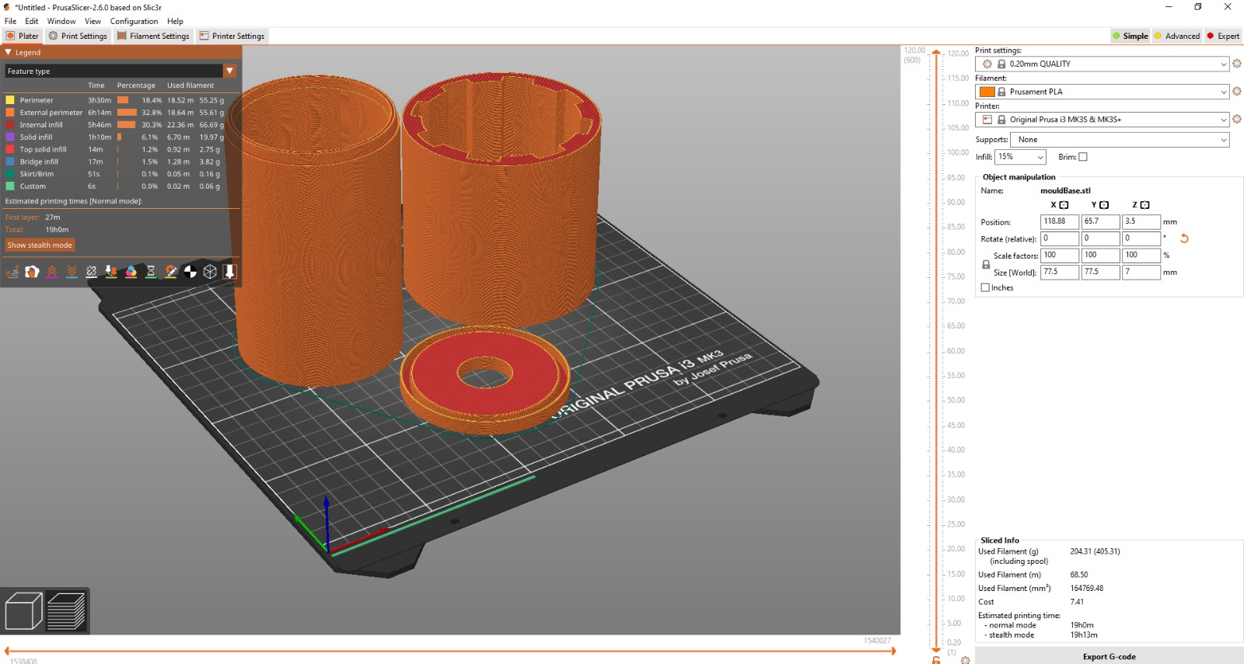
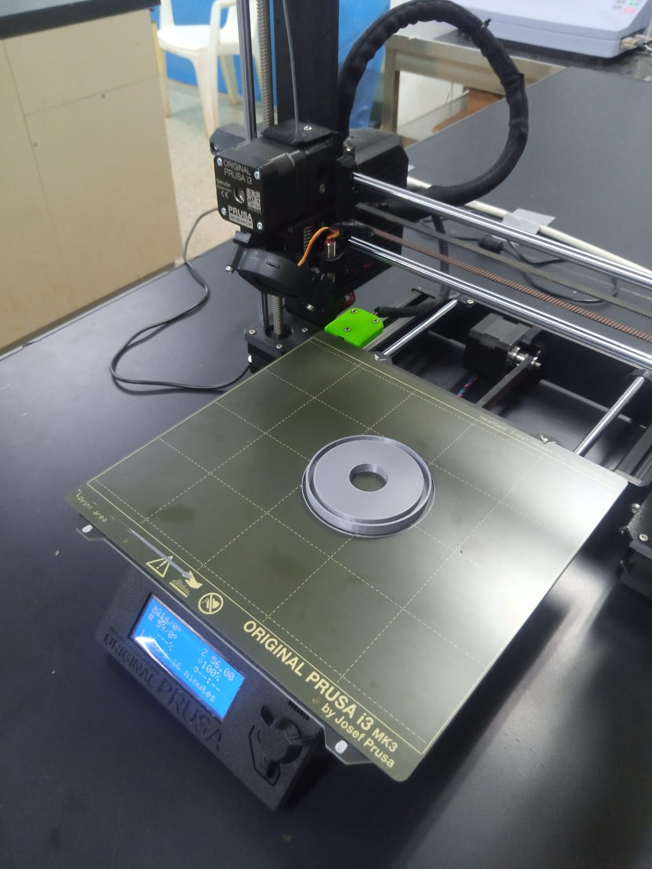
CREATE MORE CASTING TOOLS

Slide 8
NEXT WEEK’S OBJECTIVES
FINISH UP ON THE 2 GRAIN MOTOR.
COOK 2 FULL GRAINS.
CONDUCT STATIC TEST.

Slide 9
THANK YOU

